Slide 1
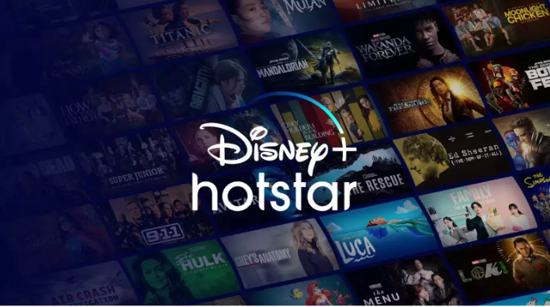
Rexton Machado-MBE11
Disney+HotStar
Data Analysis

Slide 2

Objectives:
1.Data cleaning and preprocessing
2.Data visualization with Power BI
3.Data analysis and interpretation
4.Creating interactive dashboards
5.Understanding key business metrics in the food delivery industry

Slide 3
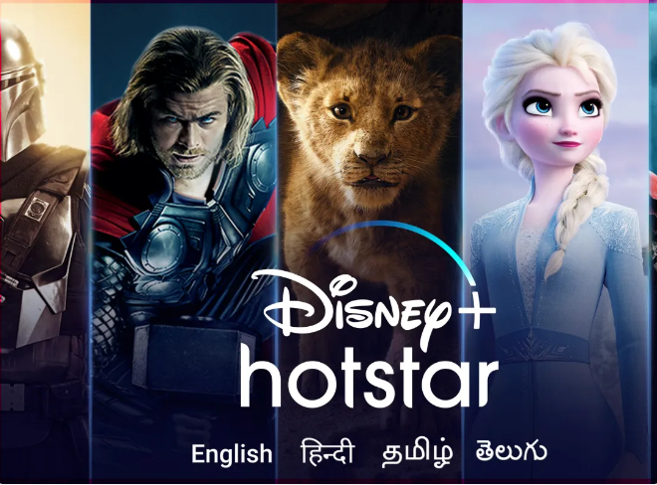
Project Overview:
The project Disney hotstar Analysis provide an in-depth analysis and visualization of a movie dataset to uncover insights and trends. This includes understanding the distribution of movies by genre, running times, release years, age ratings, and other attributes.

Slide 4
Data Cleaning 🧹
In the data cleaning phase, Power Query was utilized to refine the extracted dataset from Swiggy, ensuring its accuracy and consistency for further analysis. Several key cleaning processes were implemented:
1.Cleaning Duplicate Data: Duplicate records within the dataset were identified and eliminated using Power Query. Removing duplicates ensured that each entry was unique, preventing any distortions in the analysis due to redundant information.
2. Removing Null Values: Null or missing values in the dataset were identified and removed to enhance data completeness. Power Query allowed for the easy identification and filtering out of these null values, ensuring that the dataset was comprehensive and reliable for subsequent analysis.

Slide 5
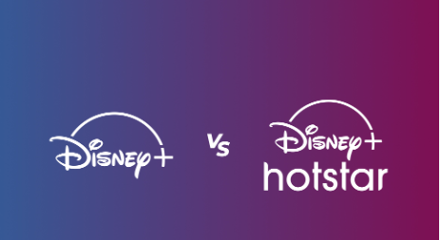
HotStar
Hotstar, now rebranded as Disney+ Hotstar, is one of the leading over-the-top (OTT) streaming platforms in India and beyond. Originally launched in February 2015 by Novi Digital Entertainment, a subsidiary of Star India, it has grown to become a dominant player in the streaming industry. After Disney's acquisition of 21st Century Fox in 2019, Hotstar was integrated with Disney+ in India, merging its extensive local and global content libraries.
Business Model
Hotstar operates on a freemium model, offering both free and premium subscription plans. Its structure includes:
Free Tier: Includes access to ad-supported content, such as select TV shows, movies, and live sports with limitations.
Paid Subscription Plans:
Disney+ Hotstar Super: Allows access to most content with ads, limited to two devices.
Disney+ Hotstar Premium: Provides ad-free access to all content, including Disney+ Originals, on four devices.

Slide 6
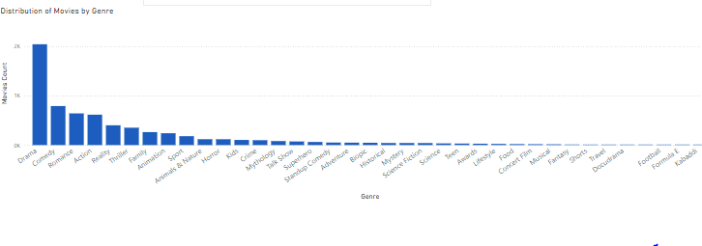
Insights
Distribution of Movies by Genre:
Most of peoples choice is on Drama in Hotstar

Slide 7
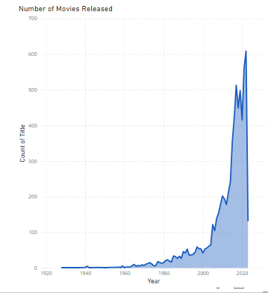
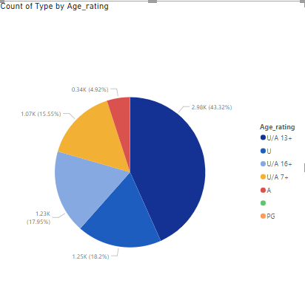
Movies Released Each Year and Movies by age rating
In the year 2023-133 movies released and the age of 13+ are watching movies 43%

Slide 8
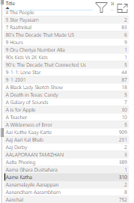
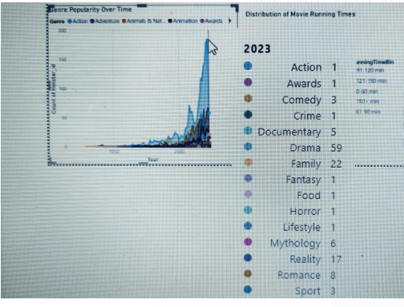
Maximum episodes and Movie Running time
Maximum episodes are in Drama genre

Slide 9
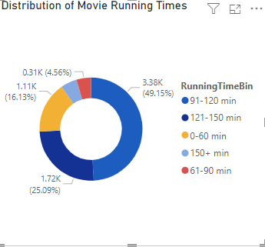
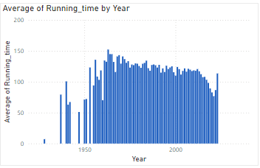
Distribution of Running Time and Average Running Time
Running time is over all capture of 49% on 91-120 mins and theAverage running time is below 150mins

Slide 10
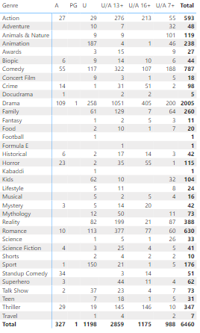
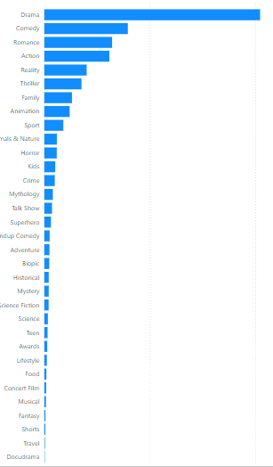
Most Common Movie Types
Drama genre is the most common watching from peoples and the least is kabaddi

Slide 11
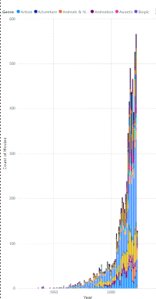
Count Of Movies released each Year and genre
In the Year 2022 was most high releasing
Mystery 15 Thriller 31
Kids 7 Reality 68
Super hero 4 Romance 38
Science Fiction 4 Horror 17
Drama 185
Over all 566 were released on different genres

Slide 12
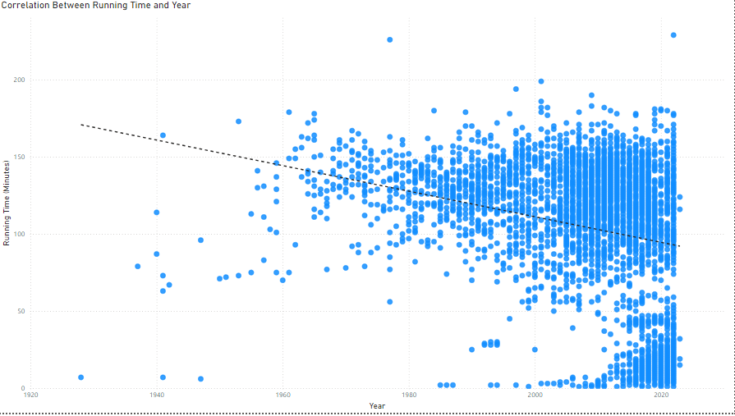
Correlation Running Time
In the year 2022 was running over the peak time
Older Movies (Pre-2000s): In the past, films, especially in India, tended to be longer (over 2.5 to 3 hours). This was due to audience expectations for elaborate storytelling, including multiple subplots, extensive song-and-dance sequences, and intermissions.
Modern Movies (2000s Onward): Over time, the global trend shifted toward shorter, more concise films (90-120 minutes). This was driven by changing audience preferences

Slide 13
Recommendation
Diversify Content Library
Regional Content: Expand offerings in regional languages like Marathi, Tamil, Bengali, etc., to attract diverse audiences.
International Titles: Partner with global studios for exclusive streaming rights to hit series and movies.
Niche Categories: Include more documentaries, indie films, and short films to cater to a wider audience.
Personalization Features
Enhanced Recommendation Engine: Use AI to recommend content based on viewing history, genres, and user preferences.
Custom Playlists: Allow users to create playlists for movies, shows, or even specific sports highlights.
Kids Mode: Include a safe, curated section for children with parental controls.
Focus on Sports
Interactive Features: Add live polls, stats, and commentary to make sports streaming more engaging.
Mini Highlights: Provide short highlight reels for users who missed the live event.
Exclusive Leagues: Secure streaming rights for popular leagues (e.g., IPL, English Premier League).
Affordable Subscription Models
Flexible Pricing: Offer daily or weekly subscription options for casual viewers.
Bundled Deals: Collaborate with telecom providers for bundled data and Hotstar access plans.
Ad-Free Tiers: Enhance premium plans with ad-free experiences and exclusive early releases.

Slide 14

Recommendation
Leverage Technology
AI-Powered Search: Implement advanced search tools to quickly find relevant content.
Smart Recommendations for New Users: Offer curated starter packs based on basic profile details.
4K Streaming: Expand 4K HDR options for premium users.
Target Emerging Markets
Localized Content: Focus on culturally relevant programming for smaller towns and rural areas.
Language Adaptation: Provide voiceovers, regional subtitles, and hyper-local storytelling.
Partner for Growth
Collaborations: Team up with other platforms (e.g., Disney+, Marvel) for joint marketing and co-produced series.
Educational Content: Partner with ed-tech platforms to host courses, tutorials, or workshops.

Slide 15

Thank You

